Slide 1
Design by Induction – Part 2
Dynamic Programming
Bibliography:
[Manber] – chap 5
[CLRS] – chap 15

Slide 2
Review:
Design of algorithms by induction
Induction used in algorithm design:
  Base case: Solve a small instance of the problem
  Assumption: assume you can solve smaller instances of the problem
  Induction step: Show how you can construct the solution of the problem from the solution(s) of the smaller problem(s)

Slide 3
Review:
Design of algorithms by induction
The inductive step is always based on a reduction from problem size n to problems of size <n.
  n -> n-1 or n -> n/2 or n -> n/4, …?
The key here is how to efficiently make the reduction to smaller problems (subproblems):
  Sometimes one has to spend some effort to find the suitable element to remove. (see Celebrity Problem)
  If the amount of work needed to combine the subproblems is not trivial, reduce by dividing in subproblems of equal size – divide and conquer (see Skyline Problem)

Slide 4
Problem:
We managed to make the reduction of a problem to problems of smaller size (subproblems).
What if some of these subproblems overlap ? (if they contain common subproblems ?)

Slide 5
Dynamic Programming
A technique for designing (optimizing) algorithms
It can be applied to problems that can be decomposed in subproblems, but these subproblems overlap.
Instead of solving the same subproblems repeatedly, applying dynamic programming techniques helps to solve each subproblem just once.

Slide 6
Dynamic Programming Examples
Binomial Coefficients
The Integer Exact Knapsack
Longest Common Subsequence

Slide 7
Binomial Coefficients
The binomial coefficient C(n, k) is the number of ways of choosing a subset of k elements from a set of n elements.
By its definition, C(n,k)=n! / ((n-k)!*k!)
This definition formula is not used for computation because even for small values of n, the values of n factorial n! get really large.
Instead, C(n,k) can be computed by following formula:
C(n,k)=C(n-1, k-1)+C(n-1, k)
C(n,0)=1
C(n,n)=1

Slide 8
Binomial Coefficients –
Simple Recursive Solution
long C(int n, int k) {
if ((k==0) || (k==n))
return 1;
else
return C(n - 1, k) + C(n - 1, k - 1);
}

Slide 9
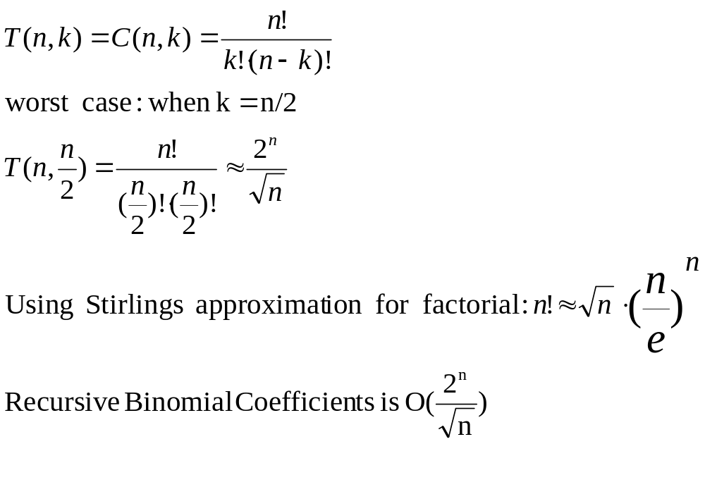
Recursive Binomial Coefficients –
Complexity Analysis

Slide 10
Binomial Coefficients –
RecursionTree for C(5,2)
C(5,2)
C(4,1)
C(4,2)
C(3,0)
C(3,1)
C(3,1)
C(3,2)
C(2,0)
C(2,1)
C(2,0)
C(2,1)
C(2,1)
C(2,2)
C(1,0)
C(1,1)
C(1,0)
C(1,1)
C(1,0)
C(1,1)

Slide 11
Optimization level 1: Memoization
We can speed up the recursive algorithm by writing down in a table the results of the recursive calls (the subproblems) and looking them up again if we need them later.
In this way we do not compute again a recursive call that was already computed before, just take the result from the table
This process was called memoization
  Memoization (not memorization!): the term comes from memo (memorandum), since the technique consists of recording a value so that we can look it up later.

Slide 12
Binomial Coefficients –
Using Memoization
ResultEntry {
boolean done;
long value;
}
ResultEntry[n+1][k+1] result;
We store results of subproblems in a table:
result[i][j] represents C(i,j)
In the beginning, all table entries must be initialized with result[i][j].done=false.

Slide 13
Binomial Coefficients –
Using Memoization (cont)
long C(int n, int k) {
if (result[n][k].done == true)
return result[n][k].value;
if ((k == 0) || (k == n)) {
result[n][k].done = true;
result[n][k].value = 1;
return result[n][k].value;
}
result[n][k].done = true;
result[n][k].value = C(n - 1, k) + C(n - 1, k - 1);
return result[n][k].value;
}

Slide 14
Binomial Coefficients –
RecursionTree with Memoization
C(5,2)
C(4,1)
C(4,2)
C(3,0)
C(3,1)
C(3,1)
C(3,2)
C(2,0)
C(2,1)
C(2,1)
C(2,2)
C(1,0)
C(1,1)
Lookup in table stops
further recursive expansion
of these nodes

Slide 15
Binomial Coefficients w. Memoization –
Complexity Analysis
T(n, k) – exactly n*k table entries are assigned exactly once

Slide 16
Optimization level 2:
Dynamic Programming
We want to eliminate recursivity
We look at the recursion tree to see in which order are done the elements of the result table
If we figure out the order, we can replace the recursion with an iterative loop that intentionally ﬁlls the table in the right order
This technique is called Dynamic Programming
  Dynamic programming: The term was introduced in the 1950s by Richard Bellman. Bellman developed methods for constructing training and logistics schedules for the air forces, or as they called them, ‘programs’. The word ‘dynamic’ is meant to suggest that the table is ﬁlled in over time, rather than all at once

Slide 17
Binomial Coefficients – Table Filling Order
result[i][j] stores the value of C(i,j)
Table has n+1 rows and k+1 columns, k<=n
Initialization: C(i,0)=1 and C(i,i)=1 for i=1 to n
0
1
k
n
0
1
1 | 1
1 |  | 1
1 |  |  | 1
1
1
1 |  |  |  |  |  |  |  | 1
1 |  |  |  |  |  |  |  |  | 1
1
Entries
that
must be
computed
i
n

Slide 18
Binomial Coefficients – Order (cont)
result[i][j] stores the value of C(i,j)
Rest of entries (i,j), for i=2 to n and j = 1 to i-1 are computed using entry (i-1, j-1) and (i-1, j)
0
1
j
k
n
0
Good order: Any order which computes entry (i,j) after computing entries (i-1, j-1) and (i-1, j)
1
i-1
i
n

Slide 19
Binomial Coefficients –
Dynamic Programming
long[][]result;
long C(int n, int k) {
result = new long [n + 1][n + 1];
int i, j;
for (i=0; i<=n; i++) {
result[i][0]=1;
result[i][i]=1;
}
for (i=2; i<=n; i++)
for(j=1; j<i; j++)
result[i][j]=result[i-1][j-1]+result[i-1][j];
return result[n][k];
}
Time: O(n*n) (or O(n*k))
Memory: O(n*n) (or O(n*k))

Slide 20
Exercise: Which order is also good for Binomial Coefficients?
for (i=2; i<=n; i++)
for(j=i-1; j>0; j--)
result[i][j]=result[i-1][j-1]+result[i-1][j];
for (i=n; i>=2; i--)
for(j=1; j<i; j++)
result[i][j]=result[i-1][j-1]+result[i-1][j];
for (j=1; j<=n; j++)
for(i=j+1; i<=n; i++)
result[i][j]=result[i-1][j-1]+result[i-1][j];

Slide 21
Optimization level 3:
Memory Efficient Dynamic Programming
In many dynamic programming algorithms, it may be not necessary to retain all intermediate results through the entire computation.
Every step (every subproblem) depends usually on a reduced set of subproblems, not all other subproblems
We replace the big table storing the results of all subproblems by some smaller buffers that are reused during the computation

Slide 22
Binomial Coefficients –
Reduce Memory Complexity
At every iteration for i, we compute the values of a row using the values of the row before it
Two buffers of the length of a row are enough
The buffers are reused after each iteration
0
1
j
k
n
0
1
i-1
Previous row
i
Current row
n

Slide 23
Binomial Coefficients –
Memory Efficient Dynamic Programming
long C(int n, int k) {
long[] result1 = new long[n + 1];
long[] result2 = new long[n + 1];
result1[0] = 1;
result1[1] = 1;
for (int i = 2; i <= n; i++) {
result2[0] = 1;
for (int j = 1; j < i; j++)
result2[j] = result1[j - 1] + result1[j];
result2[i] = 1;
long[] auxi = result1;
result1 = result2;
result2 = auxi;
}
return result1[k];
}
Time: O(n*n) (or O(n*k))
Memory: O(n) (or O(k))

Slide 24
Binomial Coefficients –
Example Implementation
Code for all versions is given in :
http://staff.cs.upt.ro/~ioana/algo/lab_dyn.html
The Binomial Coefficients solver interface:
  IBinomialCoef.java
The inefficient recursive solution
  BinomialCoefRec.java.
The recursive solution based on memoization
  BinomialCoefMemoization.java
The iterative dynamic programming solution
  BinomialCoefDynProg.java
A memory efficient dynamic programming
  BinomialCoefDynProgMemEff.java

Slide 25
Dynamic programming - Summary
Dynamic programming as an algorithm design method comprises several optimization levels:
Eliminate redundant work on identical subproblems – use a table to store results (memoization)
Eliminate recursivity – find out the order in which the elements of the table have to be computed (dynamic programming)
Reduce memory complexity if possible

Slide 26
The Integer Exact Knapsack
The problem: Given an integer K and n items of different weights such that the i’th item has an integer weight weight[i], determine if there is a subset of the items whose weights sum to exactly K, or determine that no such subset exist
Examples:
  n=4, weights={2, 3, 5, 6}, K=7; has solution {2, 5}
  n=4, weights={2, 3, 5, 6}, K=4; no solution

Slide 27
The Integer Exact Knapsack
The Integer Exact Knapsack problem has 2 versions:
  The Simple version, requesting only to find out if there is a solution.
  The Complete version, requesting to find out the list of selected items if there is a solution.
We discuss first the Simple version

Slide 28
The Integer Exact Knapsack
Strategy of solving: reduce to smaller subproblems – design by induction
P(n,K) – the problem for n items and a knapsack of K
P(i,k) – the problem for the first i<=n items and a knapsack of size k<=K

Slide 29
The Integer Exact Knapsack
Knapsack (n, K) is
If n=1
if weight[n]=K return true
else return false
If Knapsack(n-1,K)=true
return true
else
if weight[n]=K return true
else if K-weight[n]>0
return Knapsack(n-1, K-weight[n])
else return false
T(n)= 2*T(n-1)+c, n>2
T(n)=O(2^n)

Slide 30
Knapsack - Recursion tree
F(n,K)
F(n-1, K)
F(n-1, K-s[n])
F(n-2, K)
F(n-2, K-s[n-1])
F(n-2, K-s[n])
F(n-2, K-s[n]-s[n-1])
Number of nodes in recursion tree is O(2^{n})
Max number of distinct function calls F(i,k), where i in [1,n] and k in [1..K] is n*K
F(i,k) returns true if we can fill a sack with size k from the first i items
If 2^{n} >n*K, it is sure that we have 2^{n}-n*K calls repeated
We cannot identify the duplicated nodes in general, they depend on the values of size !
Even if 2^{n}<n*K, it is possible to have repeated calls, but it depends on the values of size[]

Slide 31
Knapsack – example
n=4, sizes={1, 2, 1, 1}, K=3
F(4,3)
F(3, 3)
F(3,2)
F(2, 3)
F(2, 2)
F(2,2)
F(2, 1)
F(1, 3)
F(1, 1)
F(1, 2)
F(1, 0)
F(1, 2)
F(1, 0)
F(1, 1)
F(1, -1)
In this example, we get to solve twice the problem knapsack(2,2) !

Slide 32
Knapsack – Memoization
Memoization: We use a table P with n*K elements, where P[i,k] is a record with 2 fields:
  Done: a boolean that is true if the subproblem (i,k) has been computed before
  Result: used to save the result of subproblem (i,k)
Implementation: in the recursive function presented before, replace every recursive call of Knapsack(x,y) with a sequence like
  If P[x,y].done
      …. P[x,y].result //use stored result
      Else
      P[x,y].result=Knapsack(x,y) //compute and store
      P[x,y].done=true

Slide 33
Knapsack – Dynamic programming
Dynamic programming: in order to eliminate the recursivity, we have to find out the order in which the table is filled out
  Entry (i,k) is computed using entry (i-1, k) and (i-1, k-size[i])
1
k
K
1
A valid order is:
For i:=1 to n do
For k:=1 to K do
… compute P[i,k]
i-1
i
n

Slide 34
Knapsack – Reduce memory
Over time, we need to compute all entries of the table, but we do not need to hold the whole table in memory all the time
For answering only the question if there is a solution to the exact knapsack (n, K) (without enumerating the items that give this sum) it is enough to hold in memory a sliding window of 2 rows, prev and curr
1
k
K
1
i-1
prev
i
curr
n

Slide 35
Knapsack – determine also the set of items
The Complete version of the problem: we are also interested in finding the actual subset that fits in the knapsack
Solution:
  we can add to the table entry a flag that indicates whether the corresponding item has been selected in that step
  This flag can be traced back from the last entry which is (n,K) and the subset can be recovered

Slide 36
Knapsack – The Complete Version
Reduce the memory complexity in the case of the complete version ?
  we can work with 2 row buffers, but we have to add to every row entry also the set of items representing the solution of this subproblem
  In the worst case (when all the n items are selected) we use the same memory as with the big table
  In the average case (when fewer items are selected) we can use less memory

Slide 37
Knapsack - Homework
Implement the solution of the Knapsack problem (the Simple version) as a memory efficient dynamic programming solution.
Part of Lab 10
  You are given an inefficient recursive implementation for KnapsackSimple_Recursive.java and its test program
  While the given recursive implementation works well for the short set, it will get stack overflow errors for the long set.
  A dynamic programming solution using a big table will most likely get out of memory errors for long sets.
  Optimize the implementations of the integer exact knapsack solvers such that they can handle long sets of weights !

Slide 38
The Longest Common Subsequence
Given 2 sequences, X ={x1; : : : ; xm} and Y ={y1; : : : ; yn}. Find a subsequence common to both whose length is longest. A subsequence doesn’t have to be consecutive, but it has to be in order.
H O R S E B A C K
LCS = OAK
S N O W F L A K E

Slide 39
The LCS Problem
The LCS problem has 2 versions:
  The Simple version, requesting only to find out the length of the longest common subsequence
  The Complete version, requesting to find out the sequence itself
We discuss first the Simple version

Slide 40
LCS
X = {x1, … xm}
Y = {y1, …,yn}
Xi = the prefix subsequence {x1, … xi}
Yi = the prefix subsequence {y1, … yi}
Z ={z1, … zk} is a LCS of X and Y .
LCS(i,j) = LCS of Xi and Yj
LCS(i,j) = 0, if i=0 or j=0
LCS(i-1, j-1)+1, if xi=yj
max(LCS(i, j-1), LCS(i-1, j)), if xi<>yj
See [CLRS] – chap 15.4

Slide 41
LCS – Dynamic programming
Entries of row i=0 and column j=0 are initialized to 0
Entry (i,j) is computed from (i-1, j-1), (i-1, j) and (i, j-1)
0
1
j
n
A valid order is:
For i:=1 to m do
For j:=1 to n do
… compute lcs[i,j]
0
0 | 0 | 0 |  | 0 |  |  |  | 0 | 0
0
0
0
0
1
i-1
i
Time complexity: O(n*m)
Memory complexity: n*m
m

Slide 42
LCS – Reduce Memory
it is enough to hold in memory a sliding window of 2 rows, previous and current
0
1
j
n
0
0 | 0 | 0 |  | 0 |  |  |  | 0 | 0
0
0
0
0
1
i-1
previous
i
current
Time complexity: O(n*m)
Memory complexity:2* n
m

Slide 43
LCS – The Complete Version
The Complete version of the problem: we are also interested in finding the characters of the longest common subset
Result is empty string
Add common character to result
LCS(i,j) = 0, if i=0 or j=0
LCS(i-1, j-1)+1, if xi=yj
max(LCS(i, j-1), LCS(i-1, j)), if xi<>yj
Just return result of a subproblem

Slide 44
LCS – The Complete Version
We must be able to restore the set of characters that form the LCS
Solution:
  we can add to the table entry a “direction field” that points to the subproblem extended by the current problem (one of the 3 possibilities: North, NW, West)
  This “direction field” can be traced back from the last entry which is (n,m) and the subset can be recovered
  Each “NW” on the direction sequence corresponds to an entry for which the character xi == yj is a member of an LCS

Slide 45
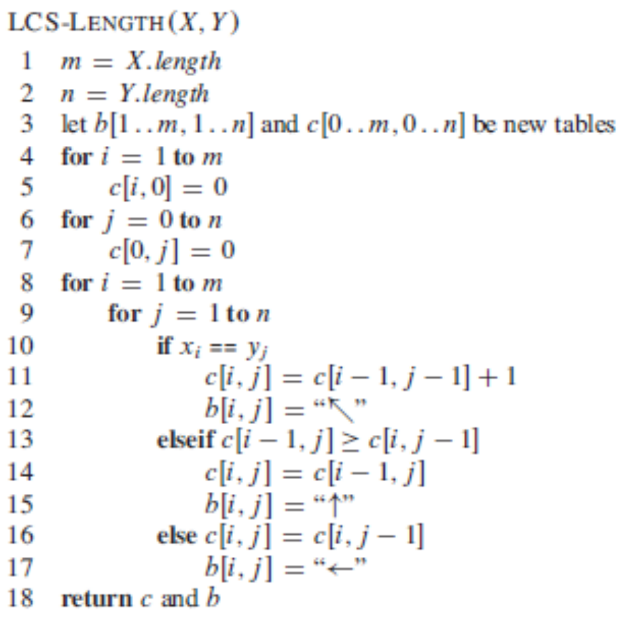
[CLRS – chap 15.4, page 394]

Slide 46
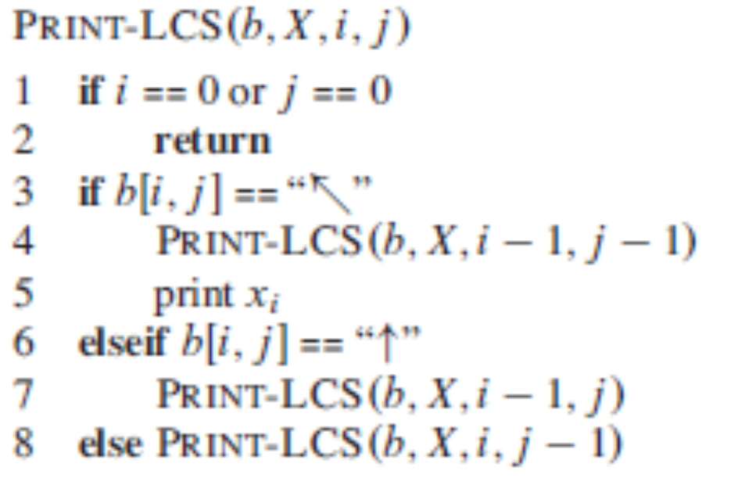
LCS – Restoring the common sequence
[CLRS – chap 15.4, page 395]

Slide 47
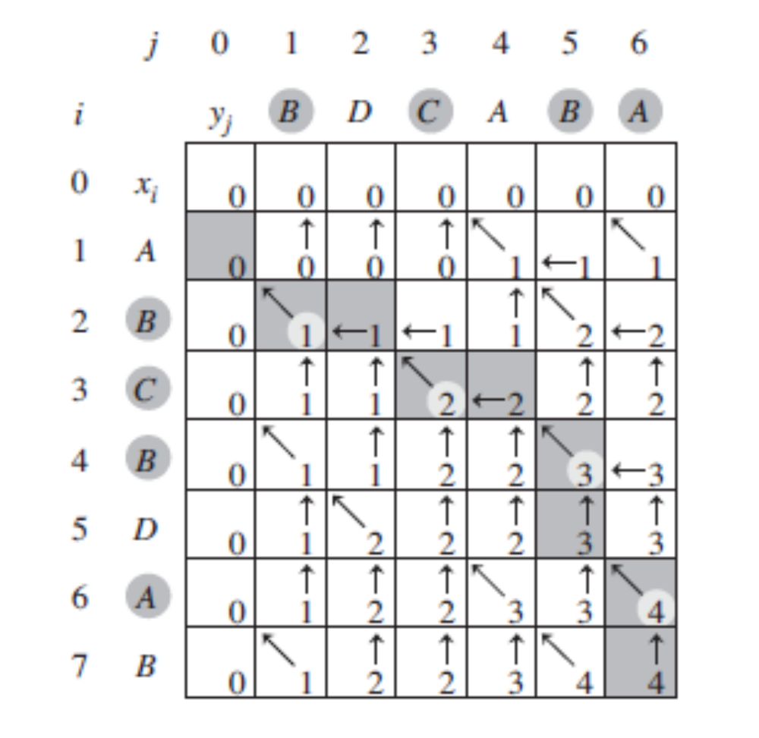
LCS - Example
[CLRS – Fig. 15.8]

Slide 48
LCS – The Complete Version
Is it possible to reduce the memory complexity in the case of the complete version ?
  we can work with 2 row buffers, but we have to add to every row entry also the set of items representing the solution of this subproblem
  In the worst case (when the strings are equal and the LCS is a string itself) we use the same memory as with the big table
  In the average case (when fewer characters are selected) we can use less memory

Slide 49
LCS - Homework
Implement the solution of the LCS problem (the Complete version) as a dynamic programming solution.
Part of Lab 10
  You are given an inefficient recursive implementation for LCS_Complete_Recursive.java and its test program
  While the given recursive implementation works well for very short strings (10 characters), it will last very long for a pair of strings of some hundreds characters.
  Optimize the implementations of the integer exact knapsack solvers such that they can handle strings of hundreds of characters !

Slide 50
LCS - applications
Molecular biology
  DNA sequences (genes) can be represented as sequences of submolecules, each of these being one of the four types: A C G T. In genetics, it is of interest to compute similarities between two DNA sequences by LCS
File comparison
  Versioning systems: example - "diff" is used to compare two different versions of the same file, to determine what changes have been made to the file. It works by finding a LCS of the lines of the two files;

